Slide 1

Introduction to Operating Systems CS/COE 1550
Spring 2020-2021
Sherif Khattab
ksm73@pitt.edu
(Some slides are from Silberschatz, Galvin and Gagne ©2013)

Slide 2
Announcements
Upcoming deadlines:
4/22: Homework 12
4/23: Lab 5
4/26: Project 4
5/2: Quiz 4
5/2: Bonus homework
Tophat questions due one week after each lecture
OMETs
1 bonus point when response rate >= 80%
currently 26-27%

Slide 3
Last Lecture …
Low-level device driver issues
memory-mapped vs port-mapped I/O
3 Ways to read/write from an I/O Device
Disk structure and scheduling

Slide 4
Muddiest Points (1/2)
Logistics
not about content but is there going to be a bonus homework?
I am currently swamped with finals and projects. Will catch up soon!
the difference between the two types of data grouping on disks
Disk Arm Scheduling
so disk requests are from different parts of the disk？
SCAN
C-SCAN
C-LOOK, SSTF, FCFS
Is there a scenario when you would use SSTF instead of SCAN/C-SCAN/C-LOOK?
Since disk scheduling is a related subproblem of traveling salesman, is there an approximately optimal solution to disk scheduling? Additionally, which of these disk scheduling algorithms is closest to what modern disks use?
What are the performance tradeoffs between SCAN, C-SCAN, and C-LOOK?

Slide 5
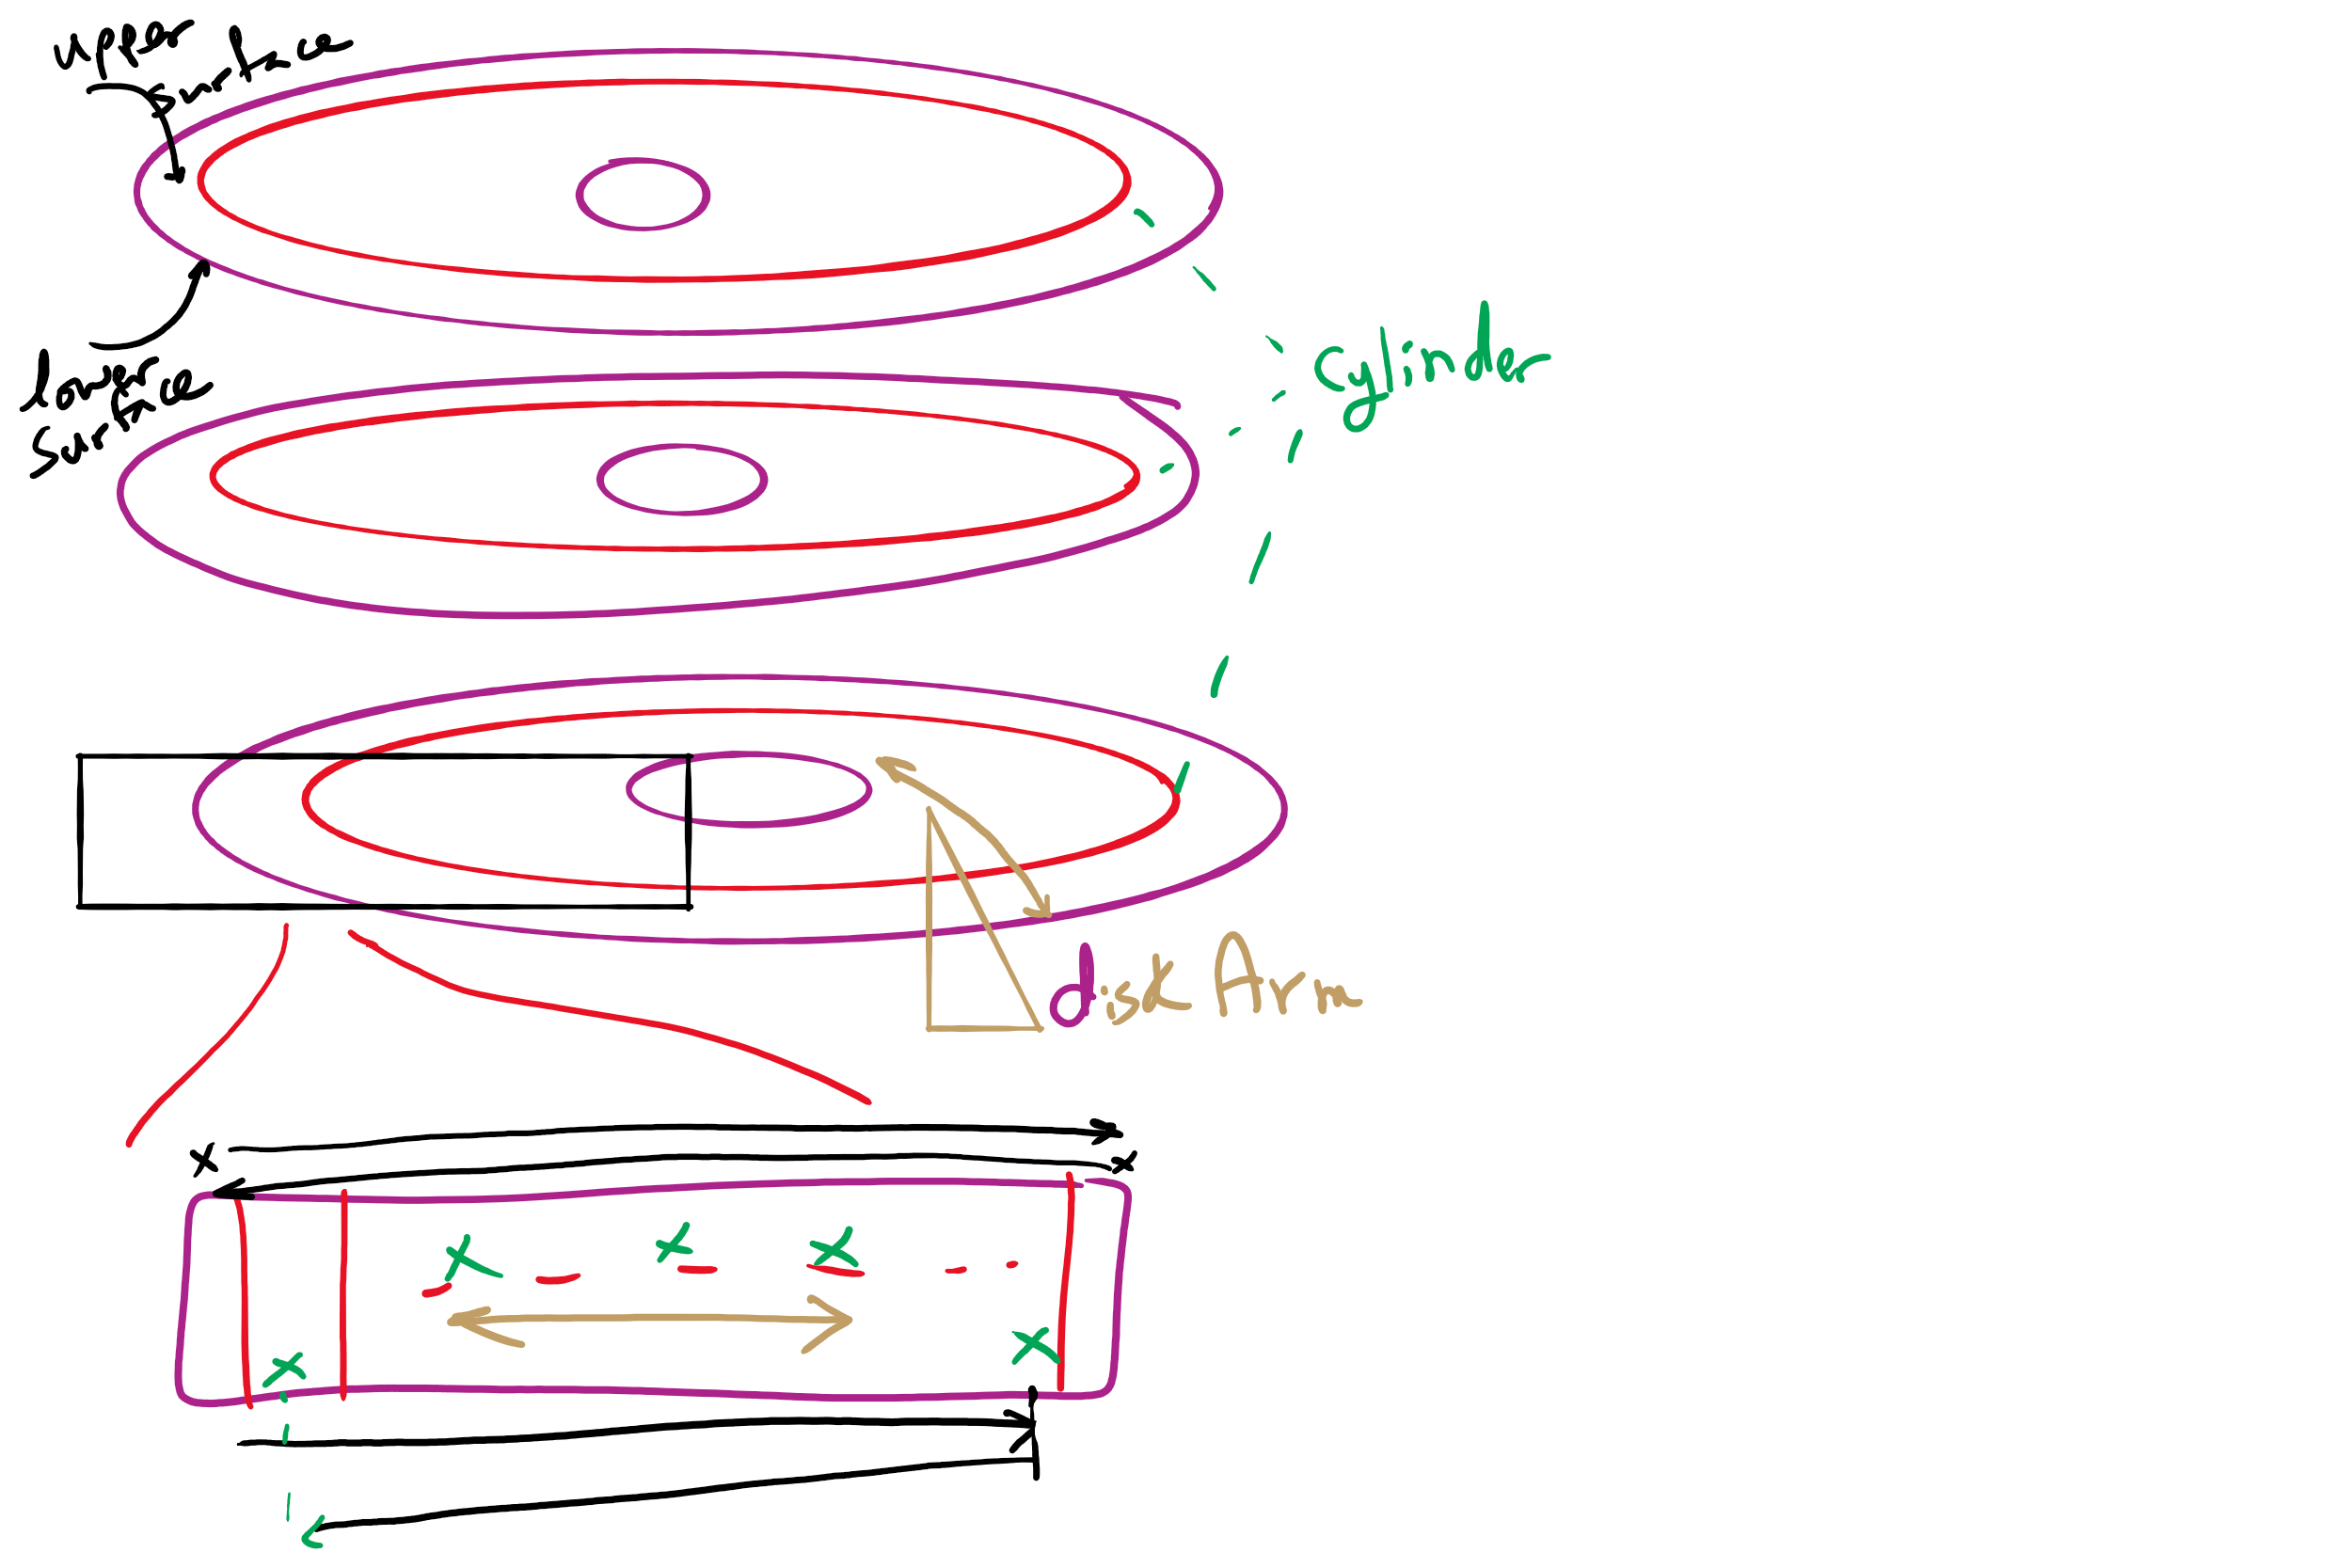
Disk Arm Scheduling

Slide 6
Muddiest Points (2/2)
HW 11
hw 12
Q 3,4,5,6,9,10,11
Programmed I/O example
DMA
adv/disadv of separate I/O and memory space, memory mapped I/O and hybrid
Project 4
Traversing the directories and subdirectory to find a file in project 4
buffering device input
i hope disk scheduling algorithms for ssd are not as silly as those for mechanical disk -_-

Slide 7
FCFS Example 1

Slide 8
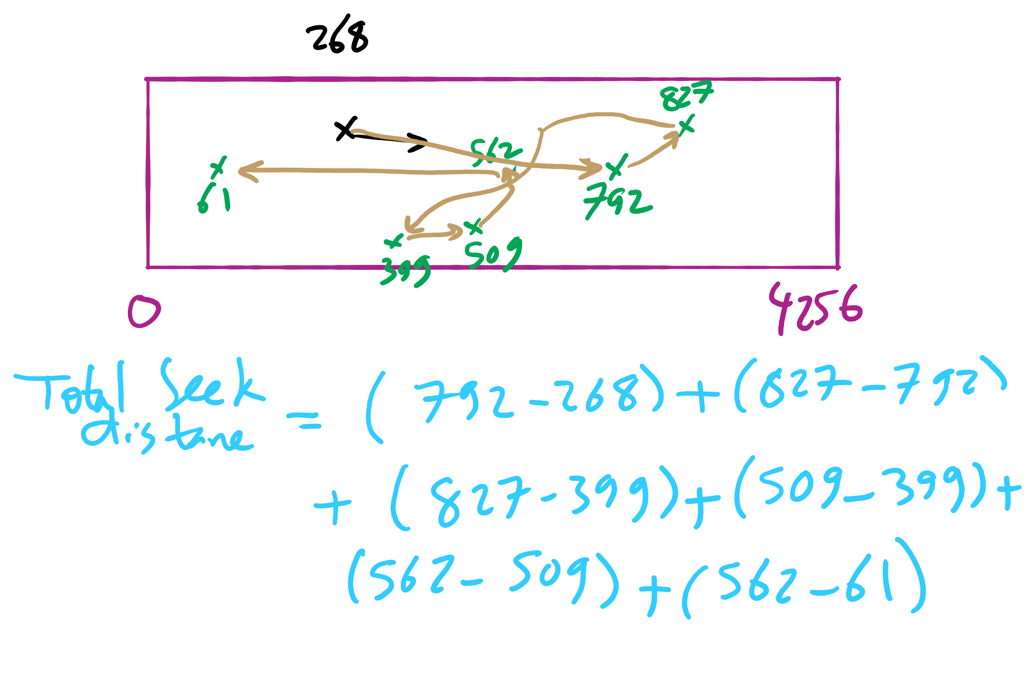
FCFS Example 2

Slide 9
SSTF Example 1

Slide 10
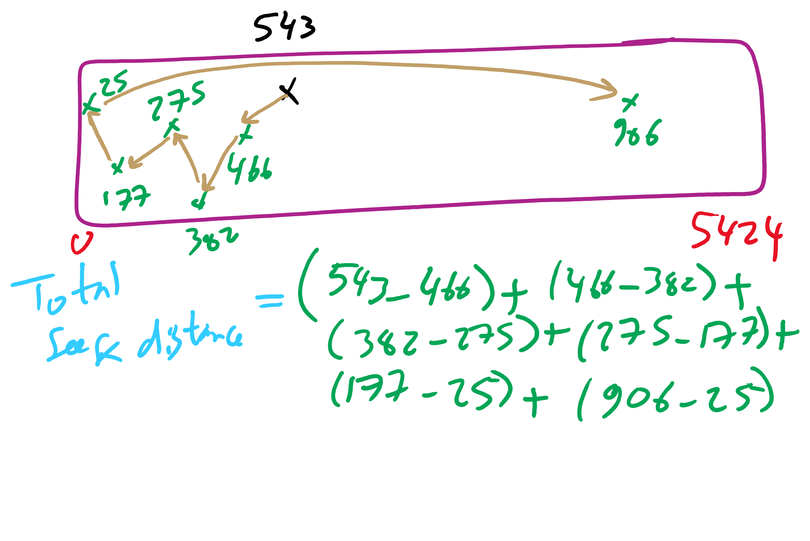
SSTF Example 2

Slide 11
SCAN Example 1

Slide 12
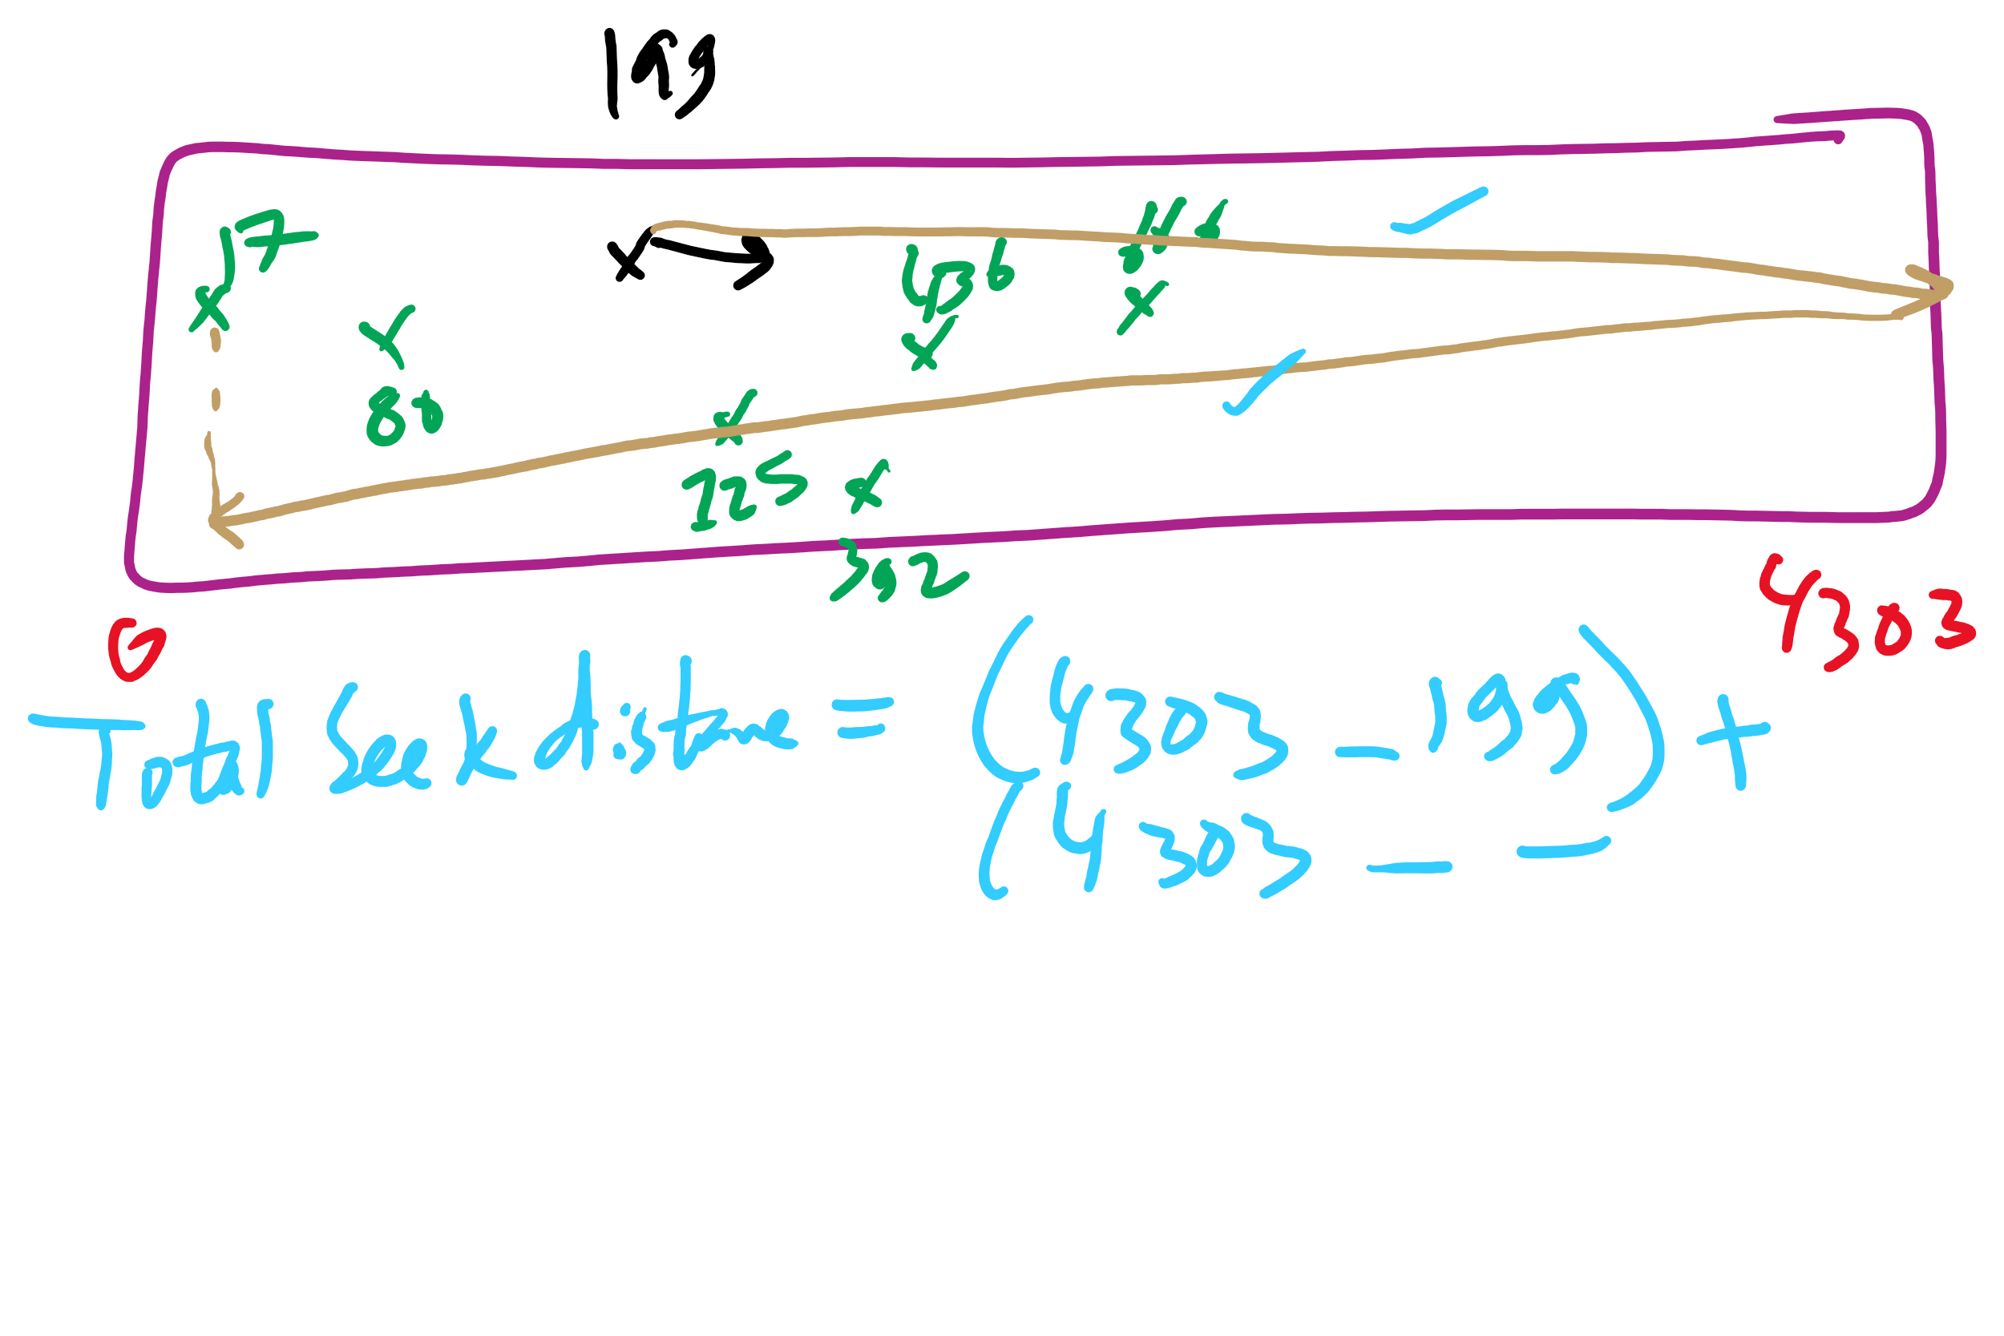
SCAN Example 2

Slide 13
C-LOOK Example 1

Slide 14
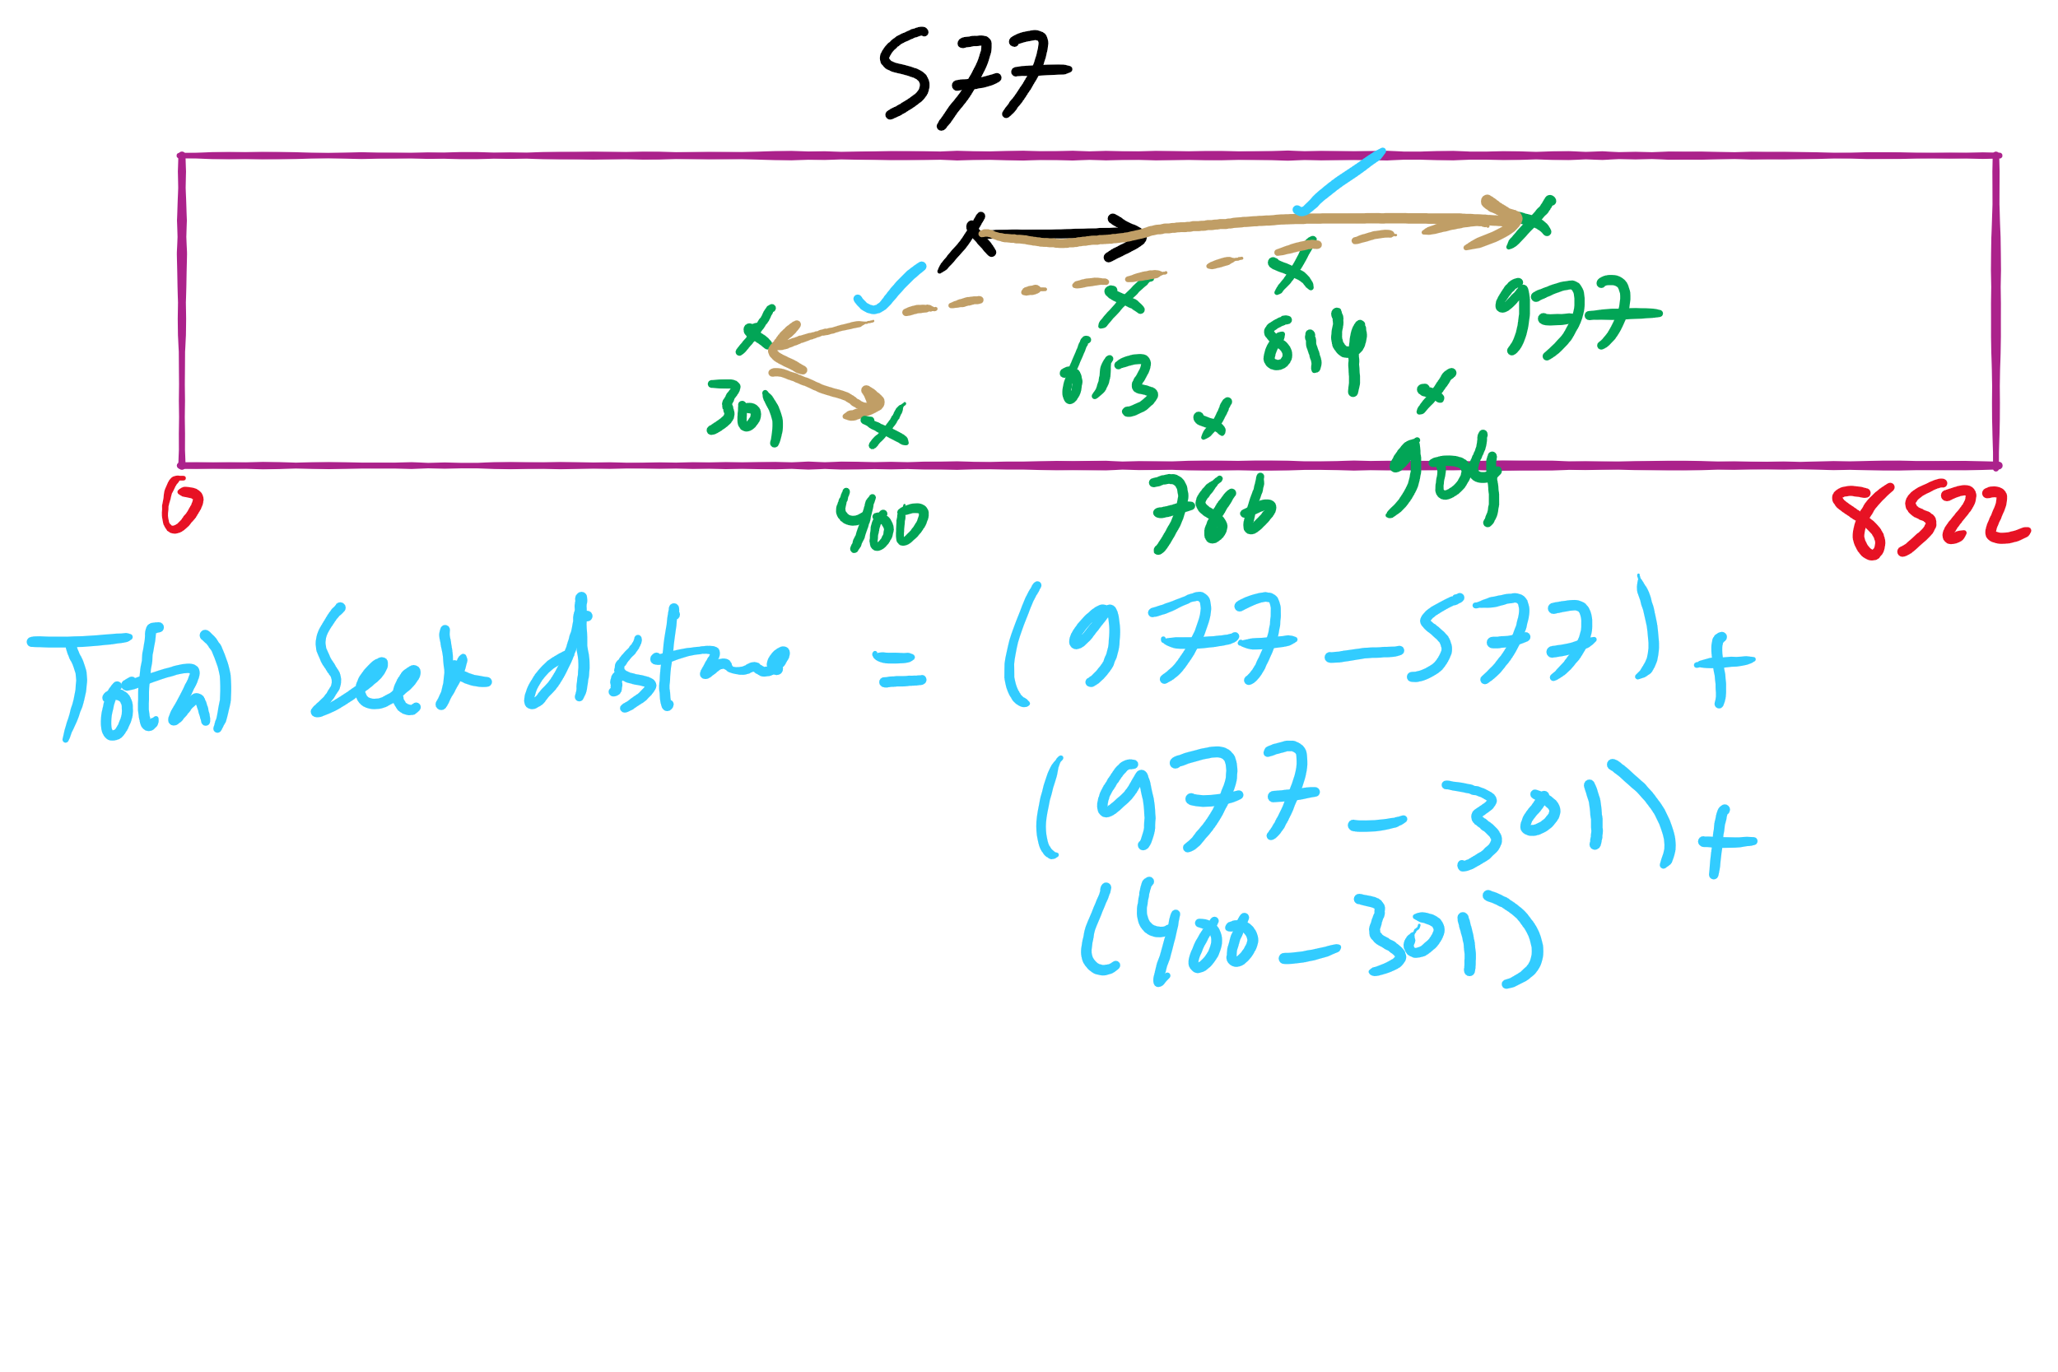
C-LOOK Example 2

Slide 15
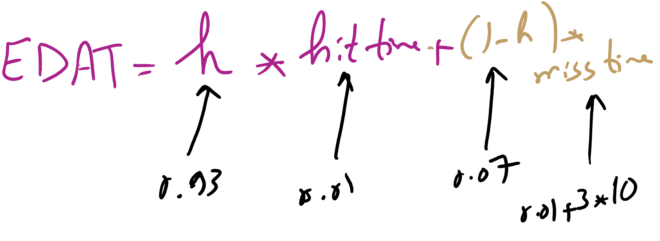
Effective Disk Access Time

Slide 16
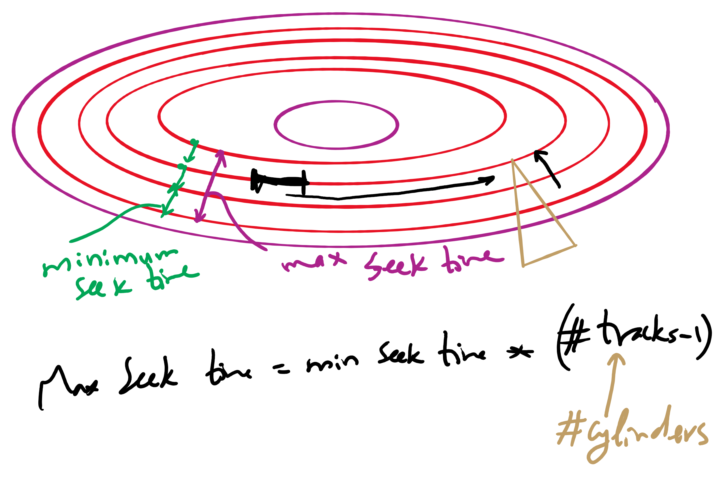
Minimum and Maximum Seek Time

Slide 17
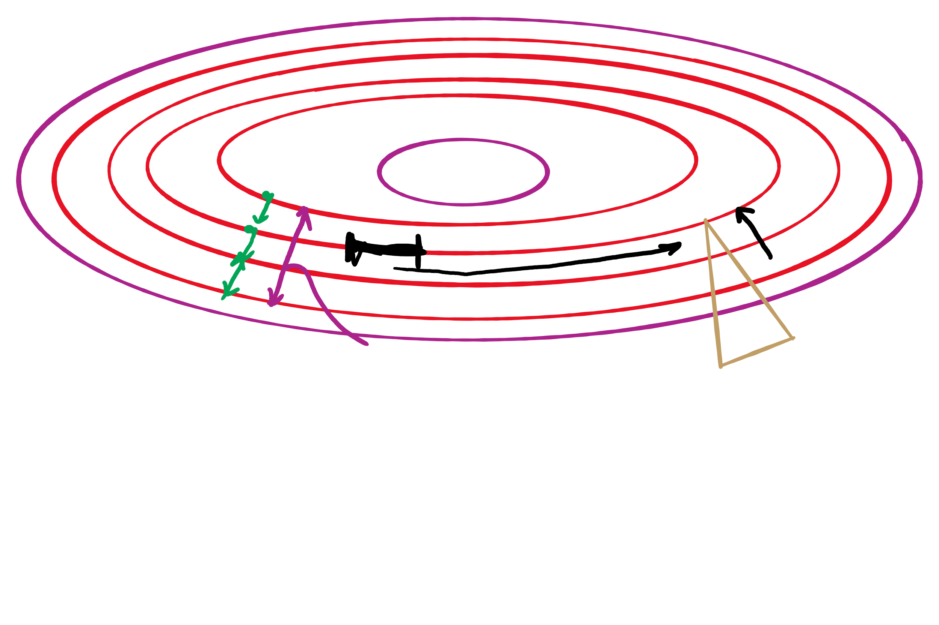
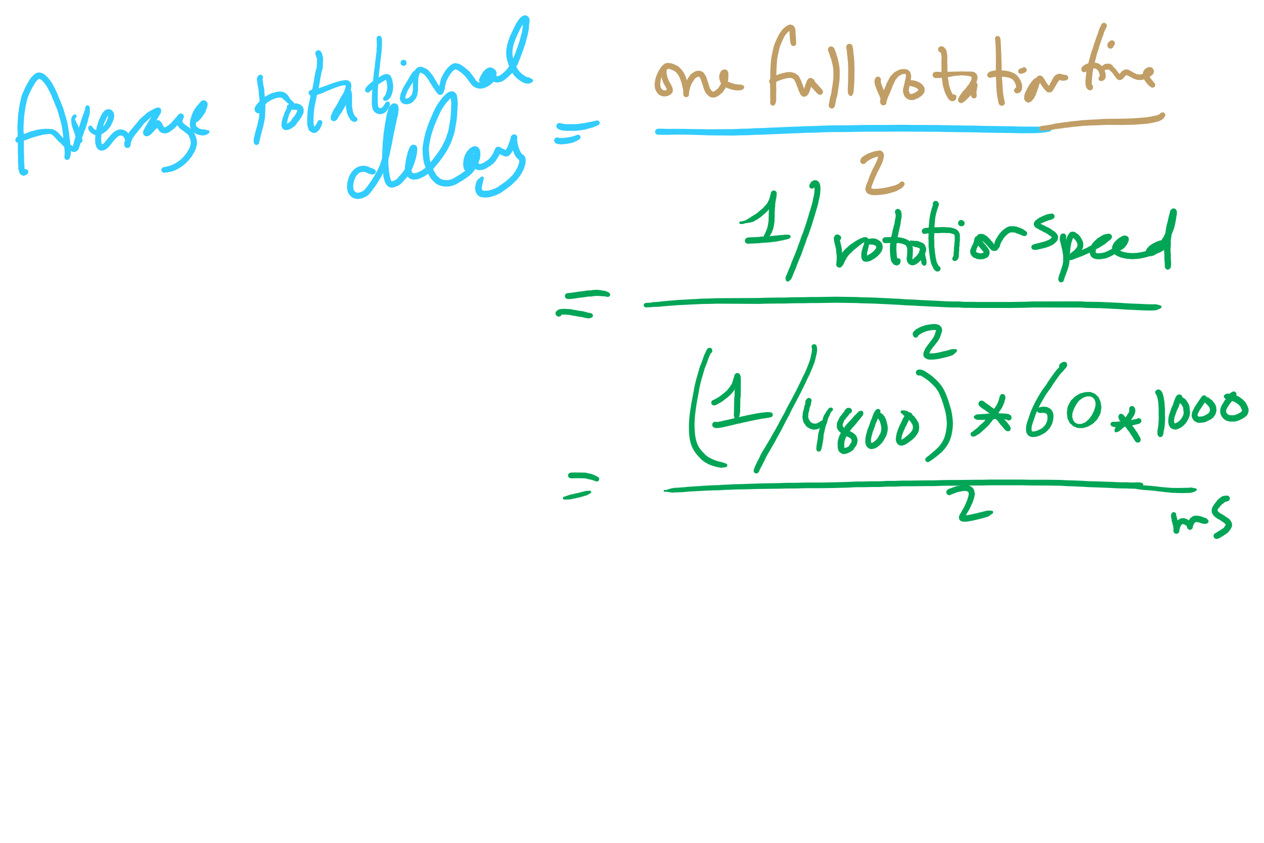
Average Rotational Delay

Slide 18
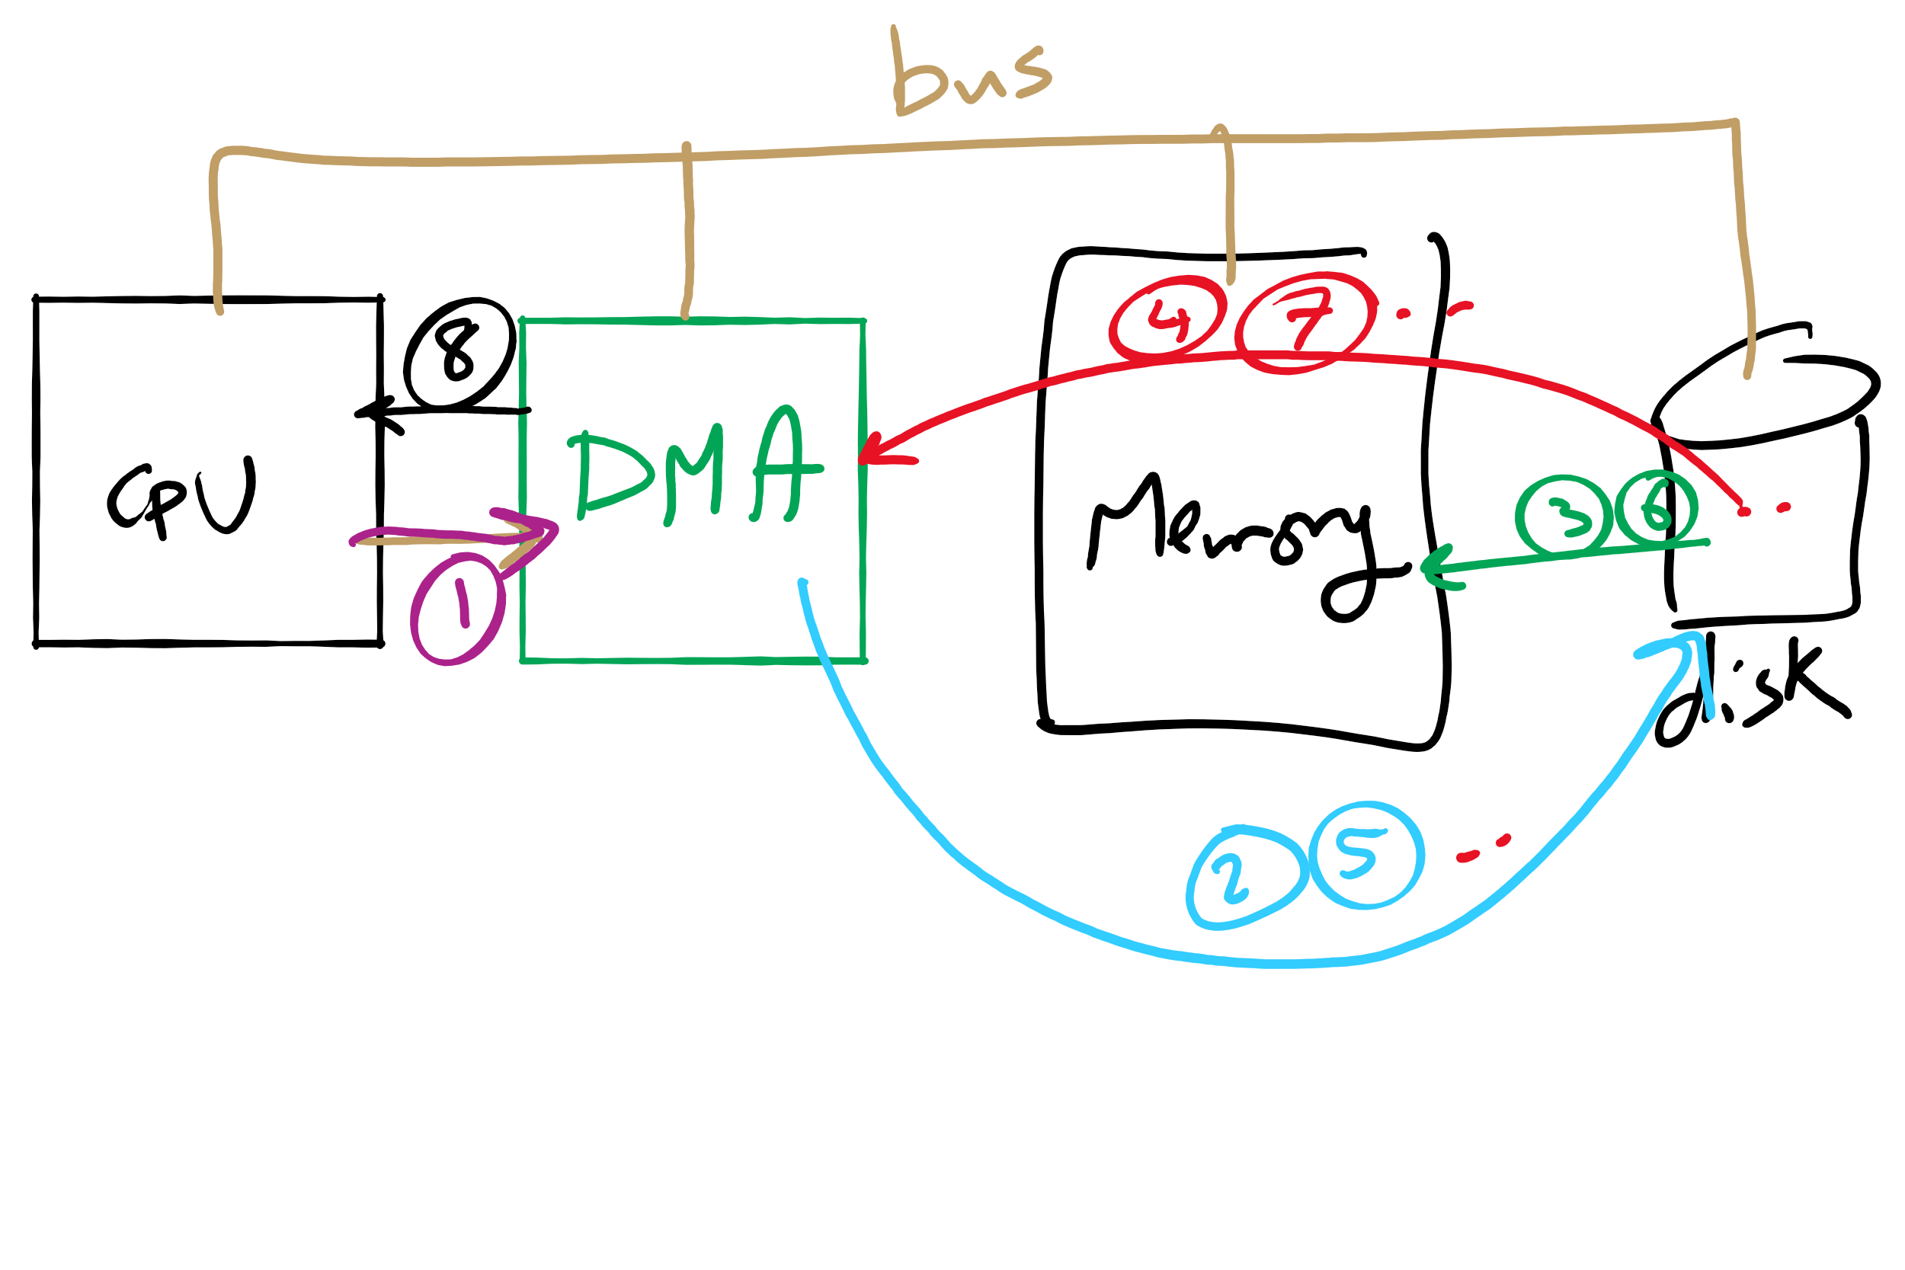
DMA

Slide 19
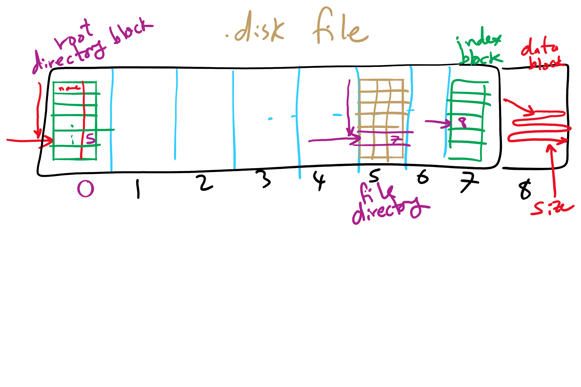
Project 4: Directory Traversal

Slide 20
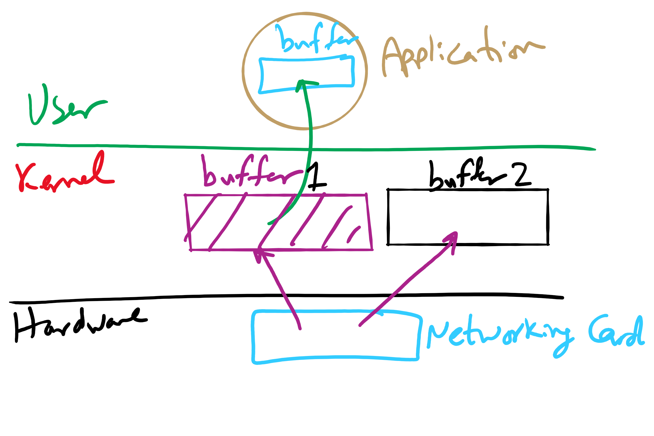
I/O Buffering

Slide 21
Today’s Agenda …
Low-level device driver issues
Disk structure and scheduling
File and Directory operations
OS Protection
Access Control Matrix

Slide 22
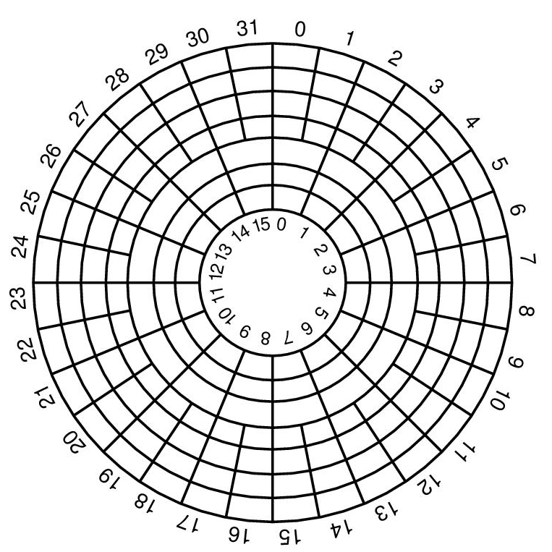
Disk “zones”
Outside tracks are longer than inside tracks
Two options
Bits are “bigger”
More bits (transfer faster)
Modern hard drives use second option
More data on outer tracks
Disk divided into “zones”
Constant sectors per track in each zone
8–20 (or more) zones on a disk

Slide 23
What’s in a disk request?
Time required to read or write a disk block determined by 3 factors
Seek time
Rotational delay
Average delay = 1/2 rotation time
Example: rotate in 10ms, average rotation delay = 5ms
Actual transfer time
Transfer time = time to rotate over sector
Example: rotate in 10ms, 200 sectors/track => 10/200 ms = 0.05ms transfer time per sector
Seek time dominates, with rotation time close
Error checking is done by controllers

Slide 24
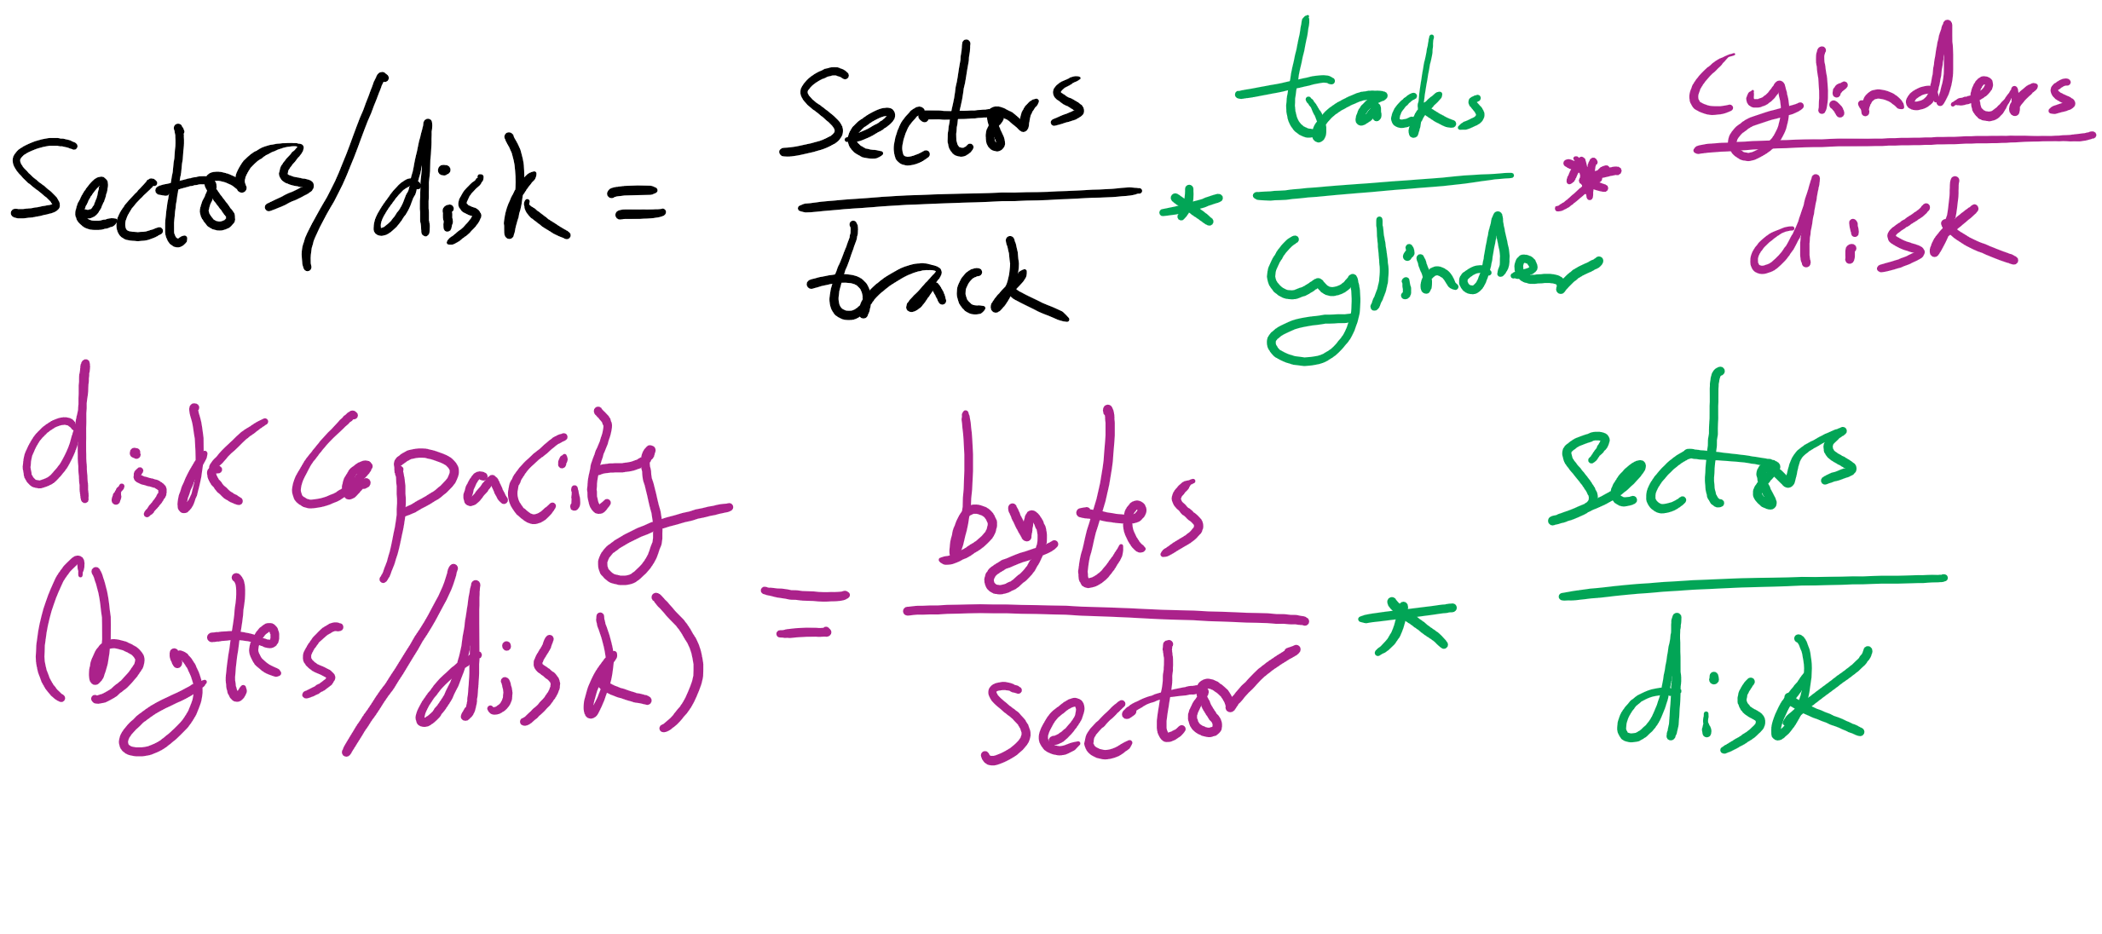
Disk drive specifics
 | IBM 360KB floppy | WD 18GB HD
Cylinders | 40 | 10601
Tracks per cylinder | 2 | 12
Sectors per track | 9 | 281 (average)
Sectors per disk | 720 | 35742000
Bytes per sector | 512 | 512
Capacity | 360 KB | 18.3 GB
Seek time (minimum) | 6 ms | 0.8 ms
Seek time (average) | 77 ms | 6.9 ms
Rotation time | 200 ms | 8.33 ms
Spinup time | 250 ms | 20 sec
Sector transfer time | 22 ms | 17 μsec

Slide 25
Long-term information storage
Must store large amounts of data
Gigabytes -> terabytes -> petabytes
Stored information must survive the termination of the process using it
Lifetime can be seconds to years
Must have some way of finding it!
Multiple processes must be able to access the information concurrently

Slide 26
Naming files
Important to be able to find files after they’re created
Every file has at least one name
Name can be
Human-accessible: “foo.c”, “my photo”, “Go Panthers!”, “Go Steelers!”
Machine-usable: 4502, 33481
Case may or may not matter
Depends on the file system
Name may include information about the file’s contents
Certainly does for the user (the name should make it easy to figure out what’s in it!)
Computer may use part of the name to determine the file type

Slide 27
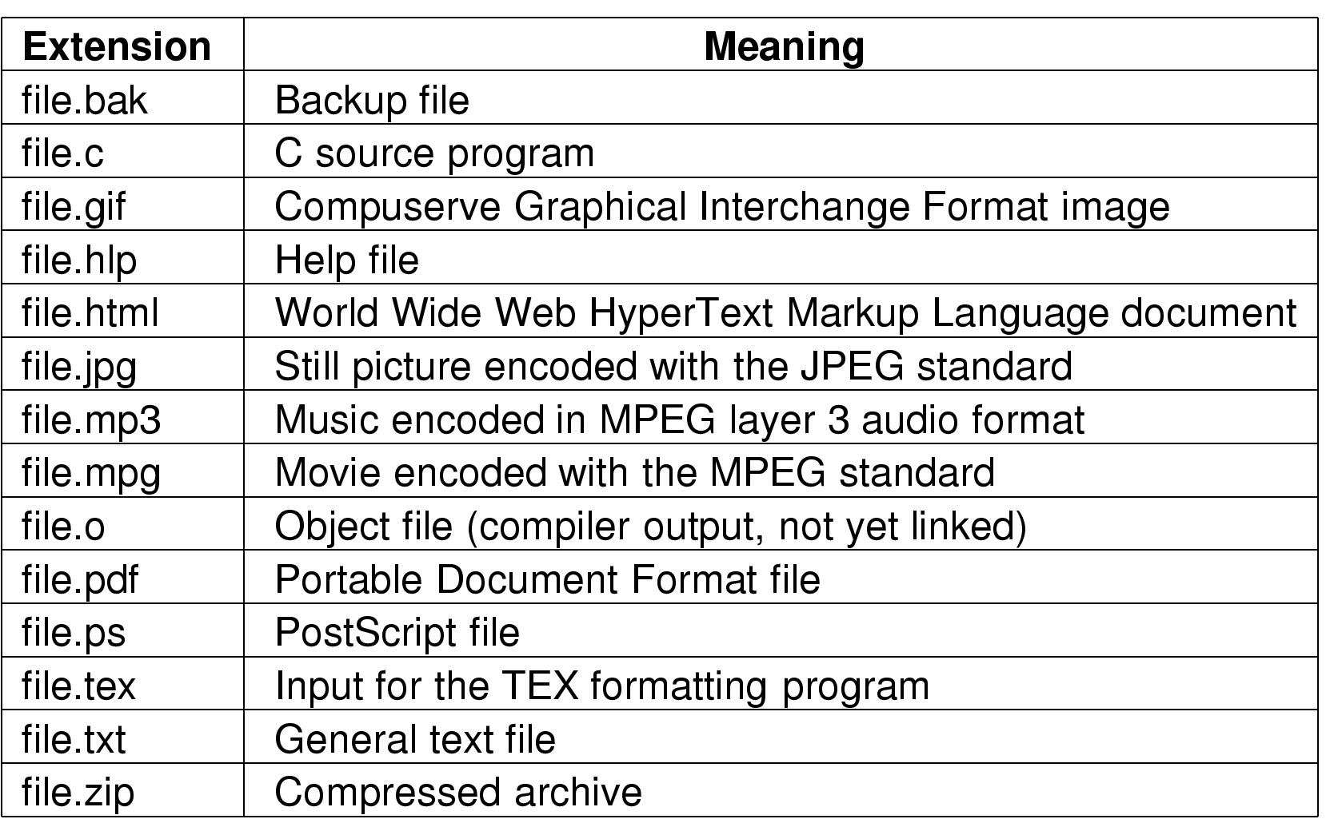
Typical file extensions

Slide 28
File structures
1 record
1 byte
401
445
1550
jr
th
tj
bg
sk
jm
dm
sk
Sequence of bytes
Sequence of records
S18
F18
S19
Tree

Slide 29
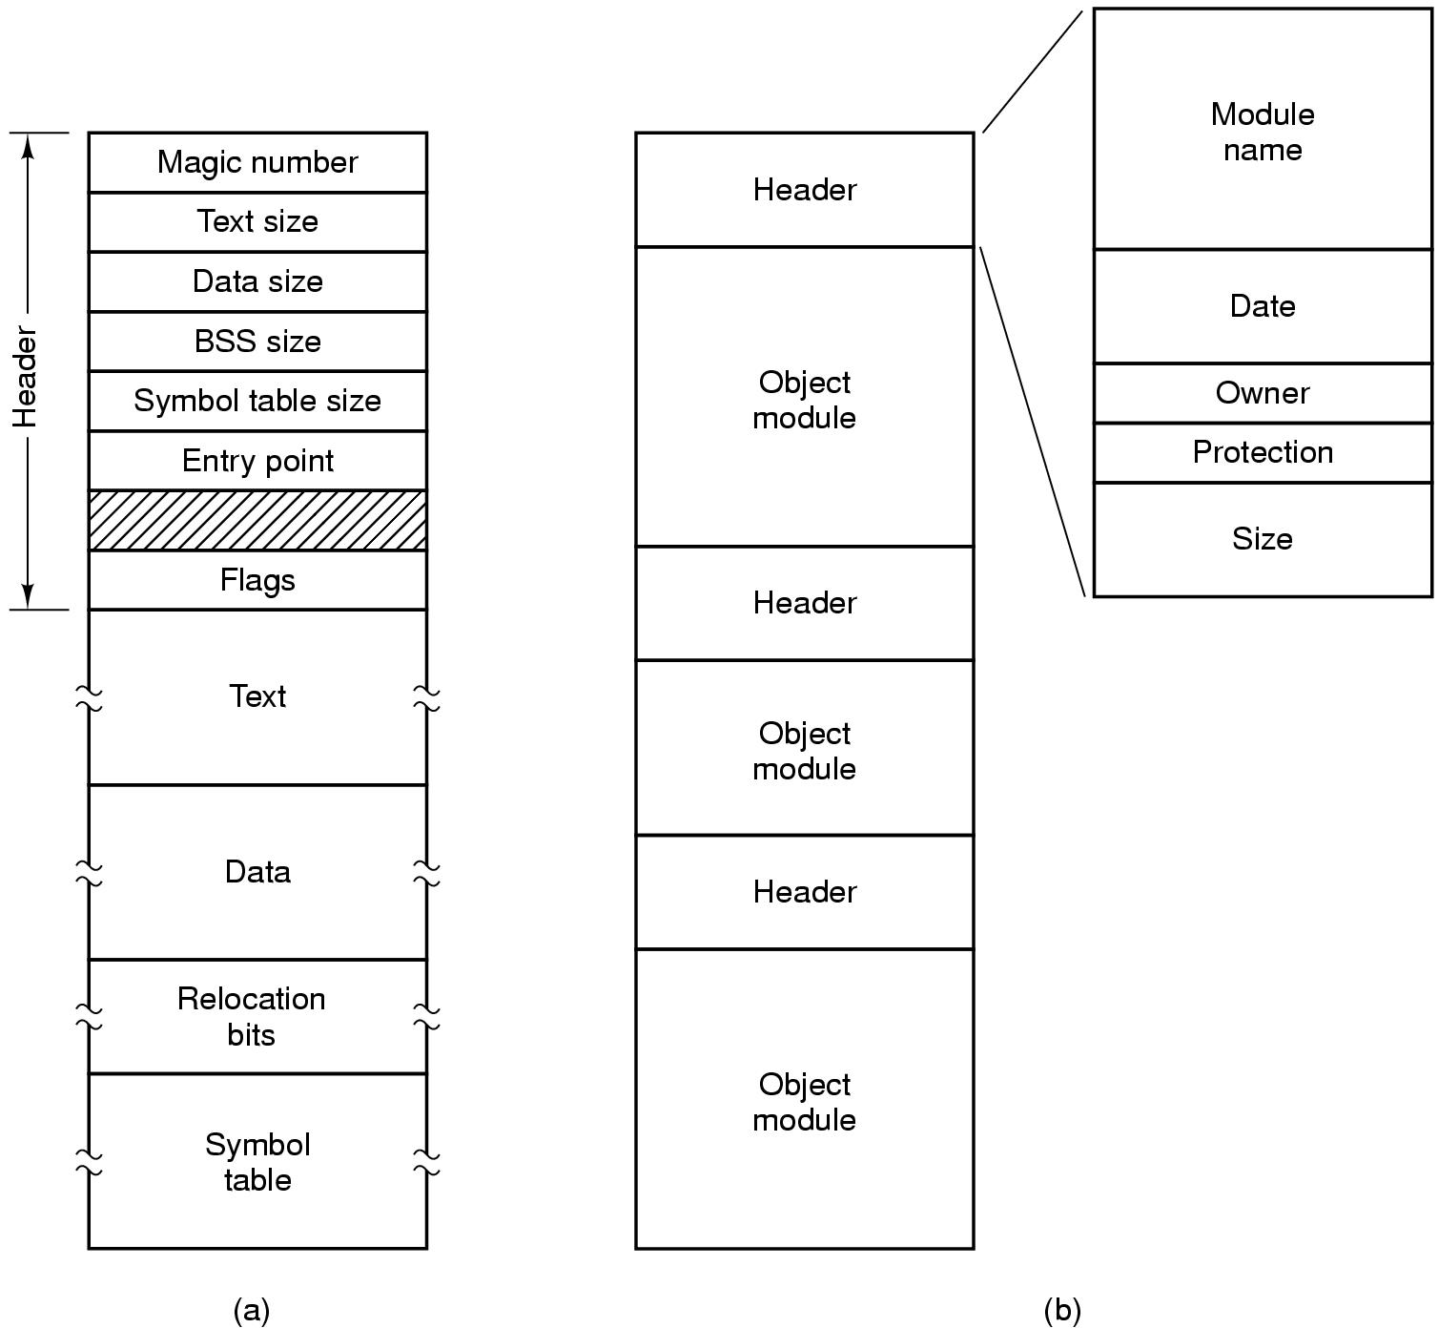
File types
Executable file
Archive

Slide 30
File operations
Create: make a new file
Delete: remove an existing file
Open: prepare a file to be accessed
Close: indicate that a file is no longer being accessed
Read: get data from a file
Write: put data to a file
Append: like write, but only at the end of the file
Seek: move the “current” pointer elsewhere in the file
Get attributes: retrieve attribute information
Set attributes: modify attribute information
Rename: change a file’s name

Slide 31
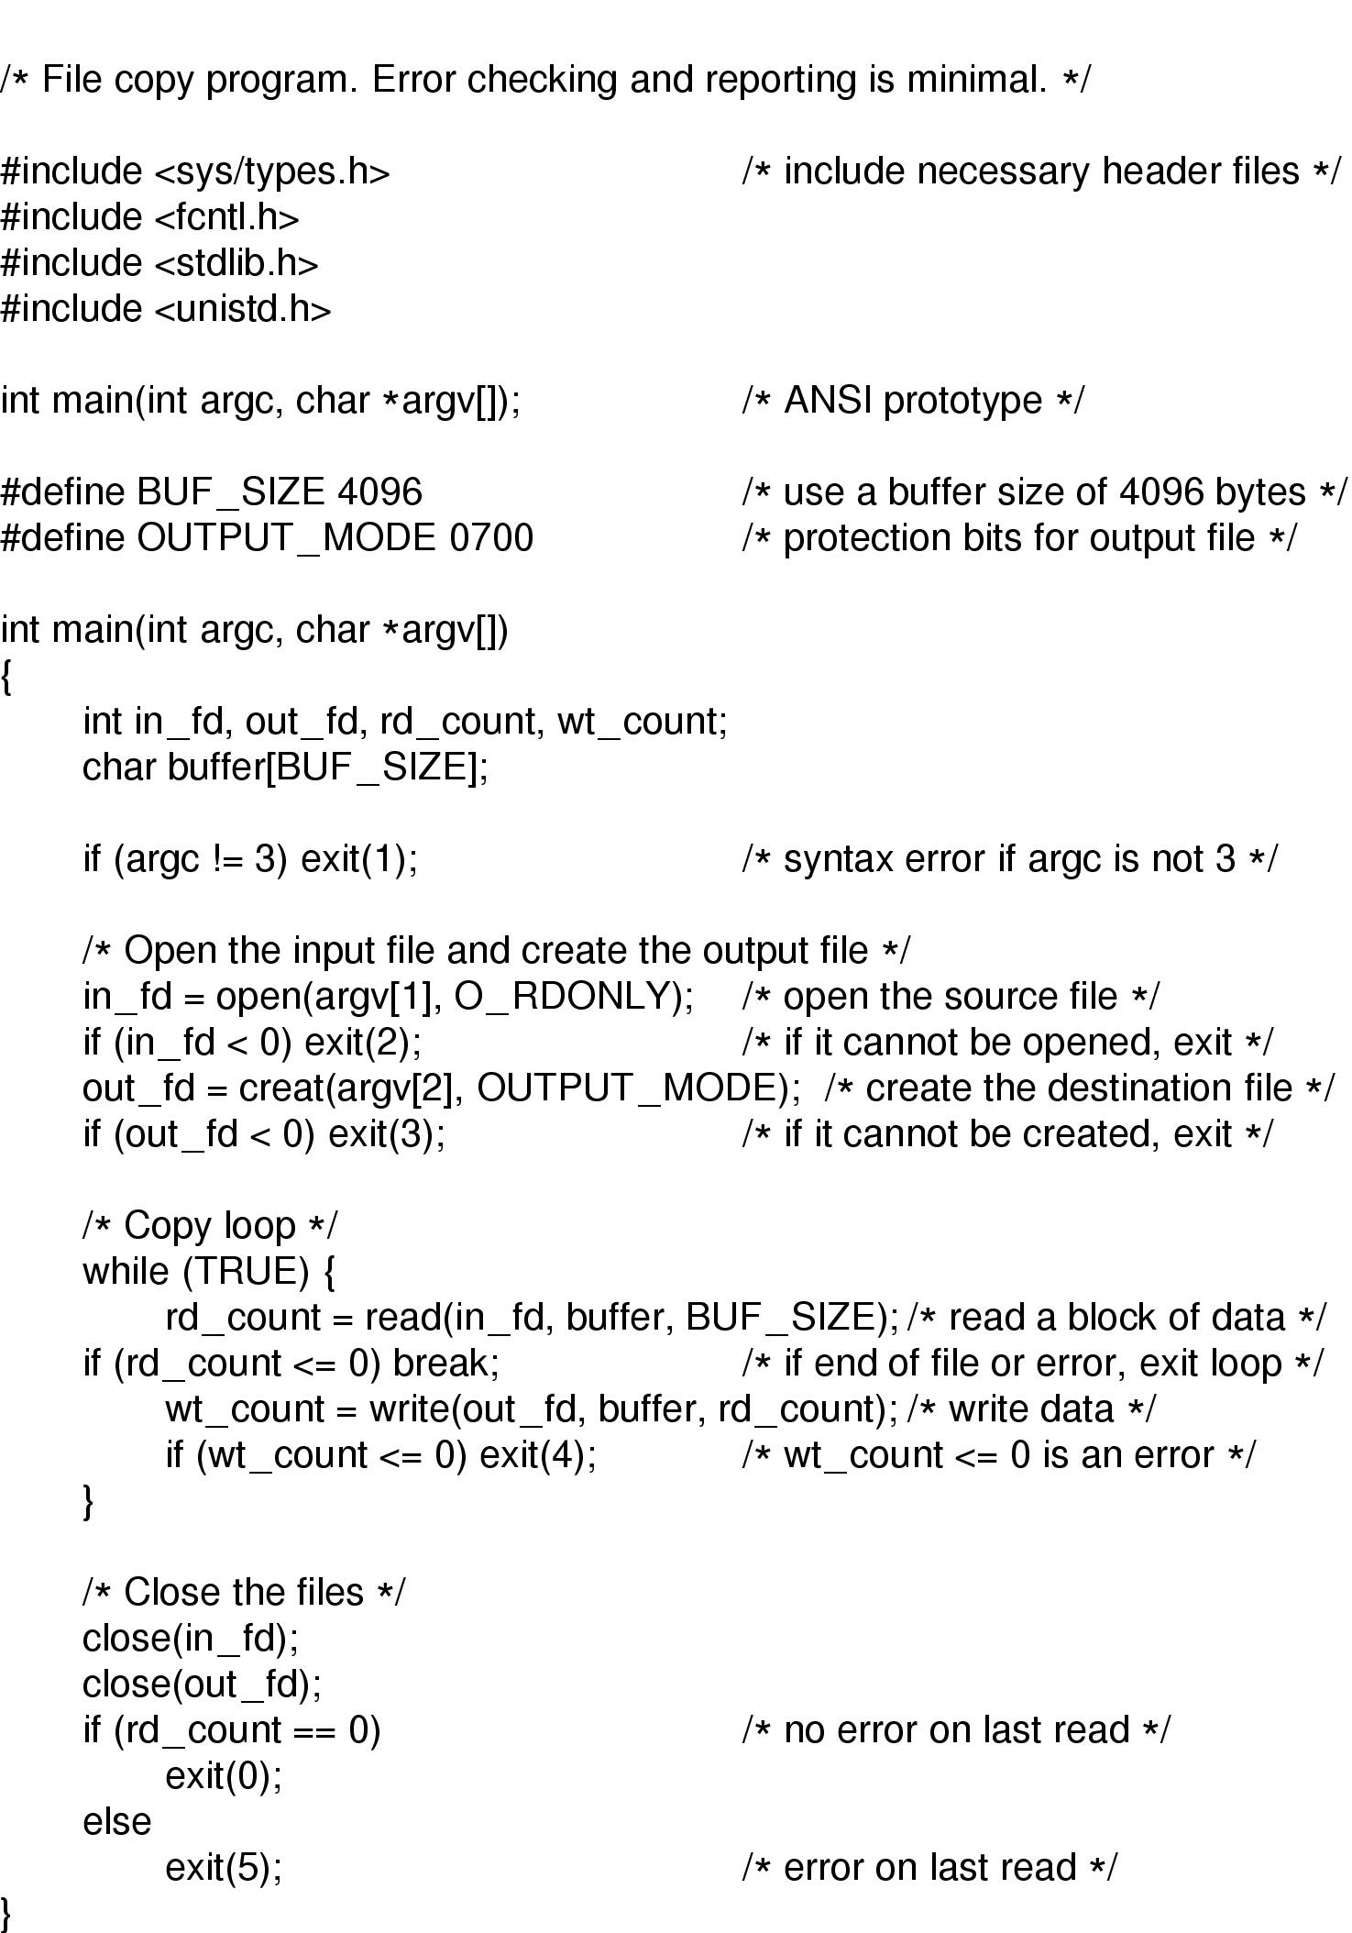
Using file system calls

Slide 32
Using file system calls, continued

Slide 33
Directories
Naming is nice, but limited
Humans like to group things together for convenience
File systems allow this to be done with directories (sometimes called folders)
Grouping makes it easier to
Find files in the first place: remember the enclosing directories for the file
Locate related files (or just determine which files are related)

Slide 34
Single-level directory systems
One directory in the file system
Example directory
Contains 4 files (foo, bar, baz, blah)
owned by 3 different people: A, B, and C (owners shown in red)
Problem: what if user B wants to create a file called foo?
Root directory
A foo
A bar
B baz
C blah

Slide 35
Two-level directory system
Solves naming problem: each user has her own directory
Multiple users can use the same file name
By default, users access files in their own directories
Extension: allow users to access files in others’ directories
Root directory
A
B
C
A foo
A bar
B foo
B baz
C bar
C foo
C blah

Slide 36
Hierarchical directory system
Root directory
A
B
C
A
Papers
A foo
A
Photos
B foo
B
Papers
C bar
C foo
C blah
A os.tex
A sunset
A
Family
B foo.tex
B foo.ps
A sunset
A kids
A Mom

Slide 37
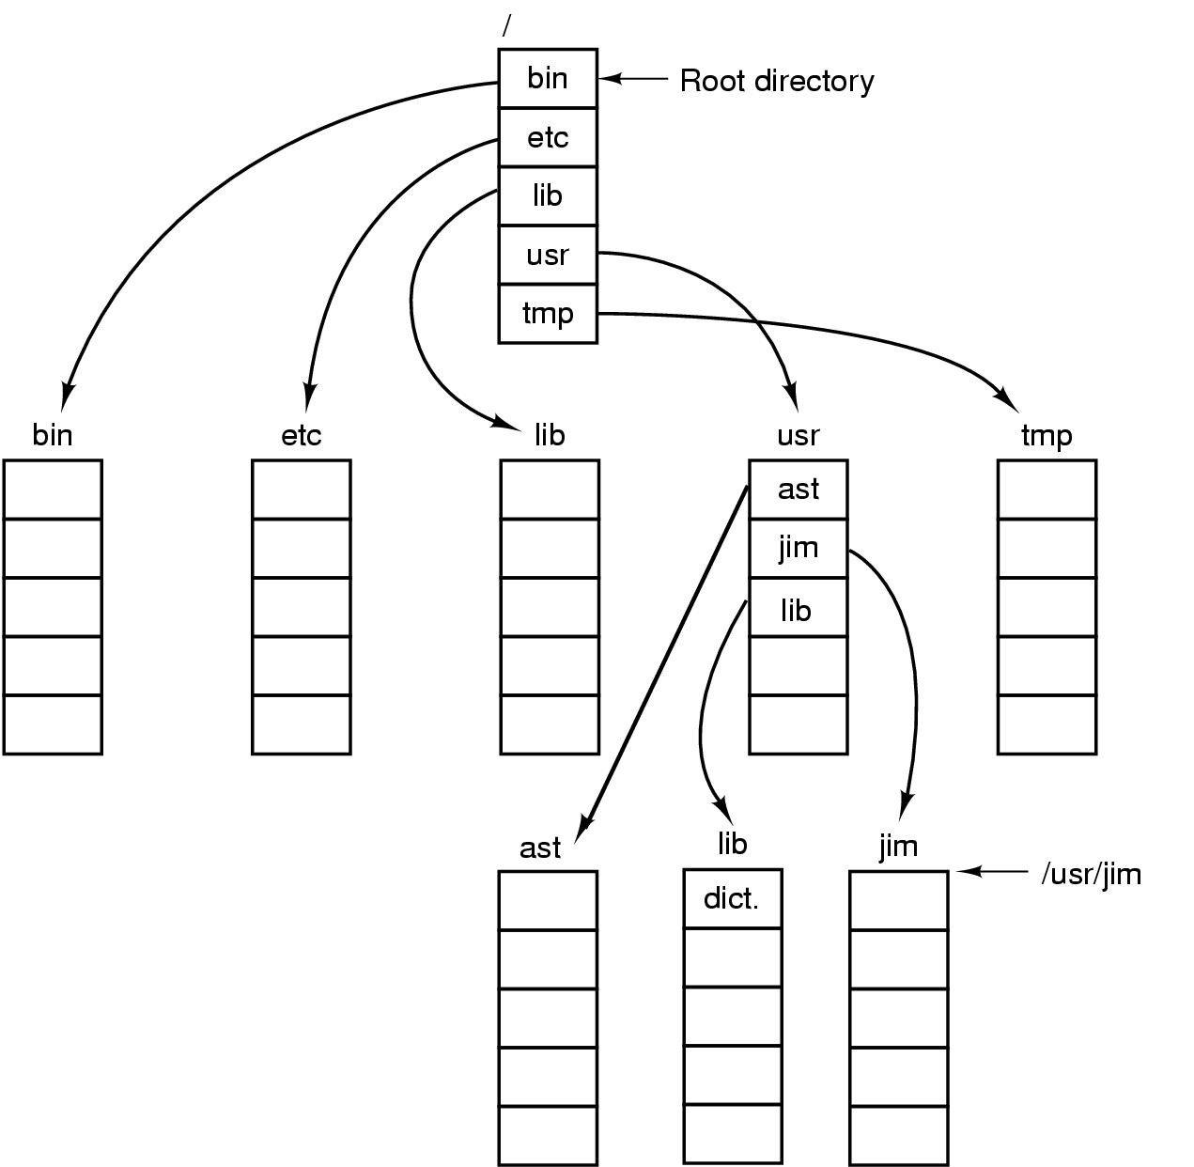
Unix directory tree

Slide 38
Operations on directories
Create: make a new directory
Delete: remove a directory (usually must be empty)
Opendir: open a directory to allow searching it
Closedir: close a directory (done searching)
Readdir: read a directory entry
Rename: change the name of a directory
Similar to renaming a file
Link: create a new entry in a directory to link to an existing file
Unlink: remove an entry in a directory
Remove the file if this is the last link to this file

